Slide 1

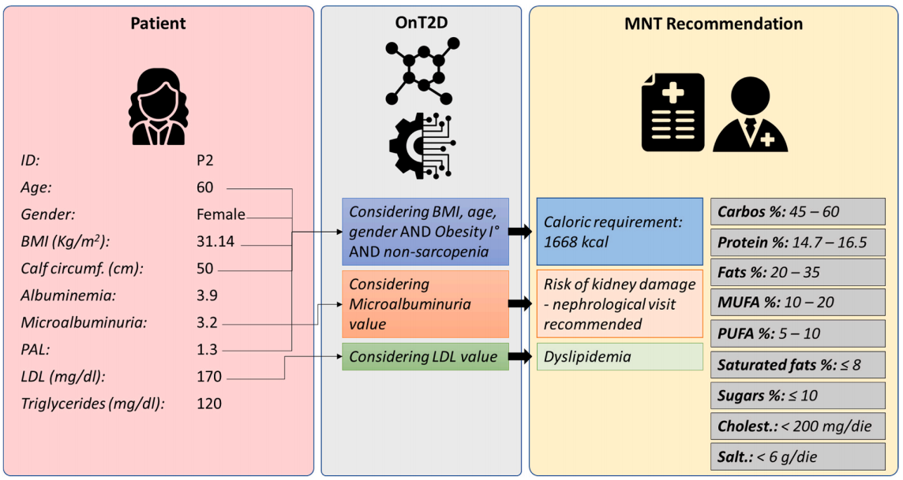


Use of AI in medicine: How the use of Knowledge-Based Systems is used to help define diets for people with diabetes.
Author: Charles Rocha | Lecturer: David McQuaid | CCT College Dublin Word count: 700
Knowledge-Based Systems (KBS) are a subset of artificial intelligence systems that facilitate sophisticated decision-making by using logical rules and a knowledge base. They are integrated in daily life without people realizing them. (Barredo Arrieta et al., 2020).
KBS are increasingly integrated into daily life across various industries and personal activities. We can see them in Customer Support as Chatbots, Virtual Assistants, or Automated Customer Services. Companies use them in E-Commerce and Streaming Services, and so on (Mohsen Soori et al., 2024). In Healthcare they can be used in Medical Diagnosis, Medication, and Symptom Checkers, and that is what we will see here.
In the medical setting, such as when treating type 2 diabetes, these technologies assist professionals in effectively monitoring patient care and customizing nutritional therapy, because it is done throgth many pacient informations, basically a roadmap of its healthy. In order to give patients specific recommendations that increase treatment accuracy and lower the possibility of mistakes, they integrate clinical data with medical guidelines (Spoladore et al., 2024).
KBS have ethical and social implications that are important to consider, such as Bias and Fairness, Transparency, Autonomy, Job Displacement, Privacy Concerns, Access and Inequality (Barredo Arrieta et al., 2020 and Mohsen Soori et al., 2024), among other that we can see below:
Negatives Impacts | Positives Impacts
Job Displacement: Automation of tasks through AI knowledge-based systems can lead to job losses in industries where human roles are replaced by machines. | Improved Decision-Making: Knowledge-based systems help make faster, more accurate decisions by analyzing vast amounts of data and identifying patterns.
Bias and Discrimination: AI systems can perpetuate biases present in the data they are trained on, leading to unfair or discriminatory outcomes in areas such as hiring, law enforcement, and lending. | Increased Efficiency: AI systems can automate repetitive tasks, freeing up human workers for more complex, creative work.
Security and Privacy Risks: Knowledge-based systems often rely on vast amounts of personal data. Mismanagement or exploitation of this data can lead to breaches of privacy, identity theft, or misuse of sensitive information. | Personalized Experiences: AI systems can adapt to individual users' preferences and behavior, creating personalized recommendations and solutions.
Over-reliance on AI: As people become more dependent on AI systems, there’s a risk of diminishing critical thinking skills or reducing the role of human judgment in complex decisions. | Access to Expertise: AI-based KBS can make expert knowledge accessible to non-experts.
Inaccurate or Misleading Outputs: AI systems can sometimes provide incorrect or misleading recommendations, especially when the quality of the data they are trained on is poor. | 24/7 Availability: AI systems can operate around the clock, offering support and decision-making capabilities without the constraints of human working hours.
In the medical environment, as can be seen above, patient data is collected to create a profile that helps in diagnosis and treatment, which must be use as a tool. This has both good and bad aspects, as we can see below:
Positive Impacts on Medicine | Negative Impacts On Medicine
Possible over-reliance on technology, leading doctors to blindly trust the system. | Improved support for clinical decision-making, leading to more effective treatments.
Concerns about patient data privacy and ethical use of collected information. | Reduced medical errors, especially in complex cases such as diabetes management.
Inequitable access to technology, potentially creating disparities in patient care. | Improved access to personalized treatment, benefiting patients in rural or low-resource areas.
These findings show that AI is a tool designed to enhance our capabilities, such as creativity and efficiency. However, its use must be approached with caution, just as we must learn to drive a car responsibly, we need to understand AI deeply to prevent it from causing harm. While it is remarkable to use AI in healthcare, it is unwise to rely on it without taking personal responsibility.
References
Spoladore, D., Stella, F., Tosi, M., Lorenzini, E.C. and Bettini, C. (2024). A knowledge-based decision support system to support family doctors in personalizing type-2 diabetes mellitus medical nutrition therapy. Computers in Biology and Medicine, 180, pp.109001–109001. doi:https://doi.org/10.1016/j.compbiomed.2024.109001.
Barredo Arrieta, A., Díaz-Rodríguez, N., Del Ser, J., Bennetot, A., Tabik, S., Barbado, A., Garcia, S., Gil-Lopez, S., Molina, D., Benjamins, R., Chatila, R. and Herrera, F. (2020). Explainable Artificial Intelligence (XAI): Concepts, taxonomies, Opportunities and Challenges toward Responsible AI. Information Fusion, 58(1), pp.82–115. doi:https://doi.org/10.1016/j.inffus.2019.12.012.
Mohsen Soori, Karimi, F., Roza Dastres and Behrooz Arezoo (2024). AI-Based Decision Support Systems in Industry 4.0, A Review. Journal of Economy and Technology. doi:https://doi.org/10.1016/j.ject.2024.08.005.
‌
‌
‌
Our Dedication.Your Journey.

